Slide 1
WELCOME
STUDENT INFORMATION PAGE

Slide 2
OBJECTIVE
To design and develop a student information webpage using HTML and CSS.
To enter the credentials of student in the web page
To improve skills in web page design, linking, and user interface development

Slide 3
TOOLS USED
HTML- To create the structure of the product webpage
CSS- To style and design the webpage
VISUAL STUDIO CODE- Code editor used for development
WEB BROWSER-To test and view the webpage

Slide 4
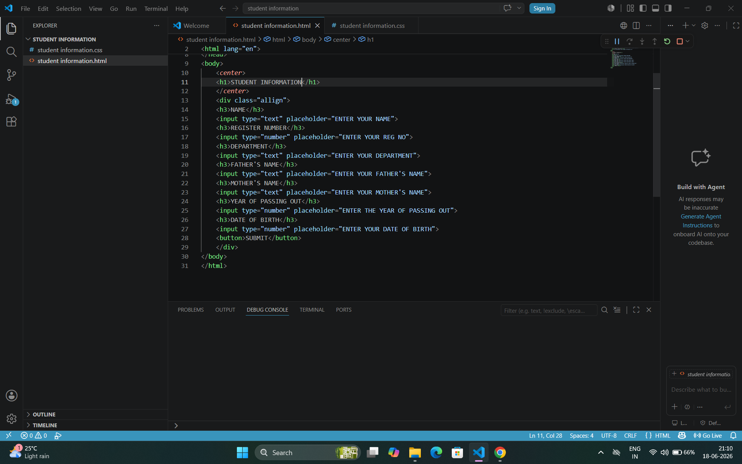
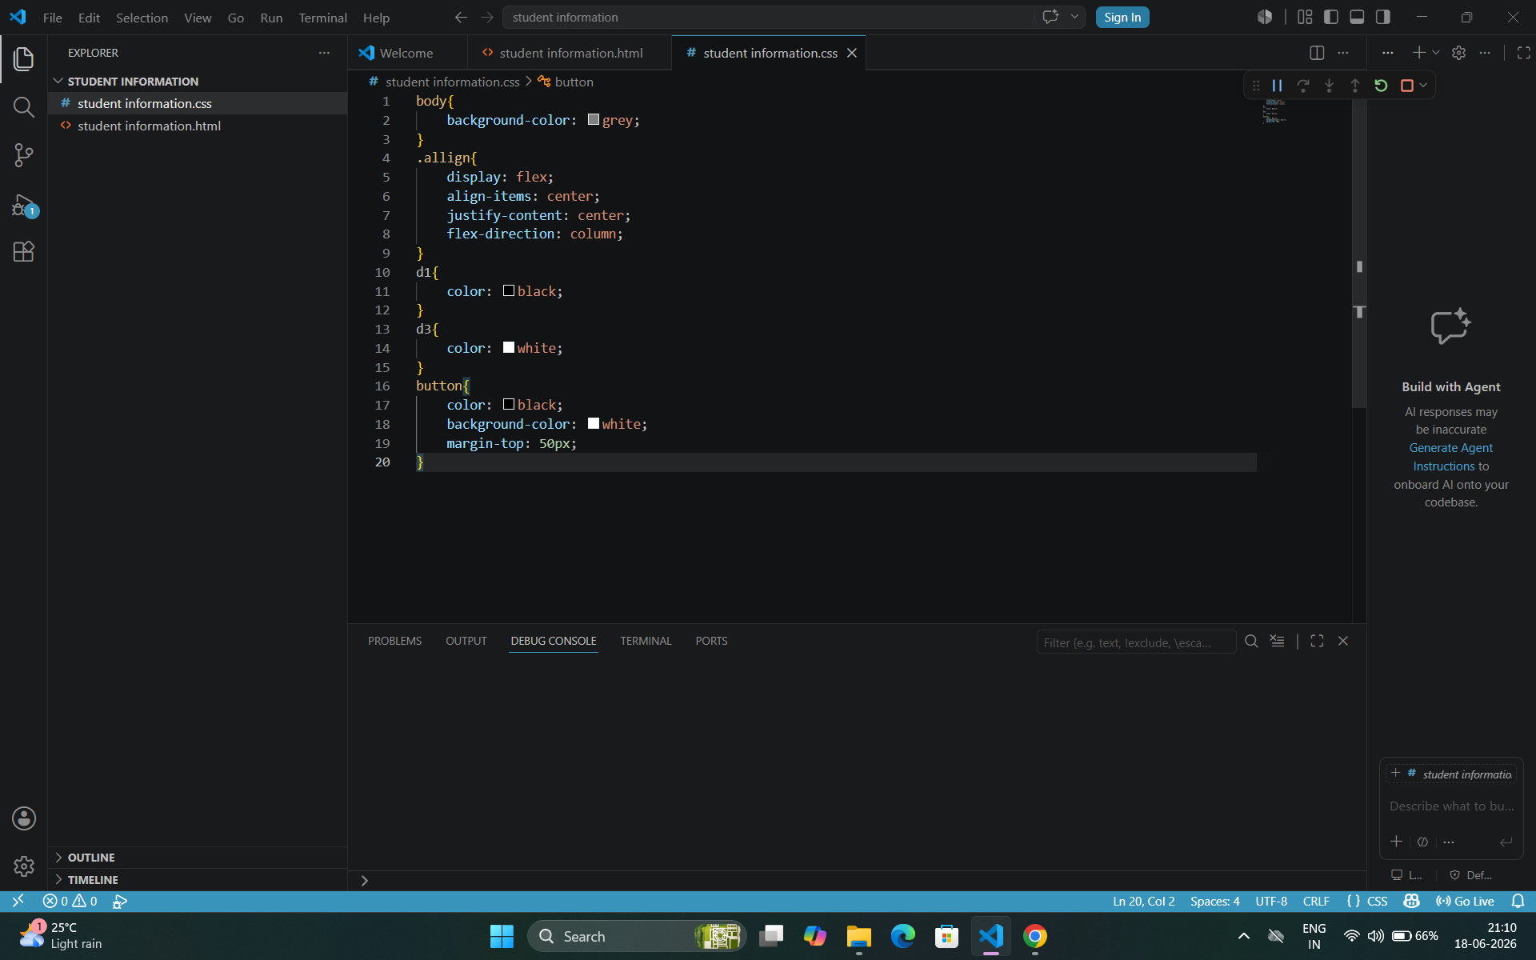
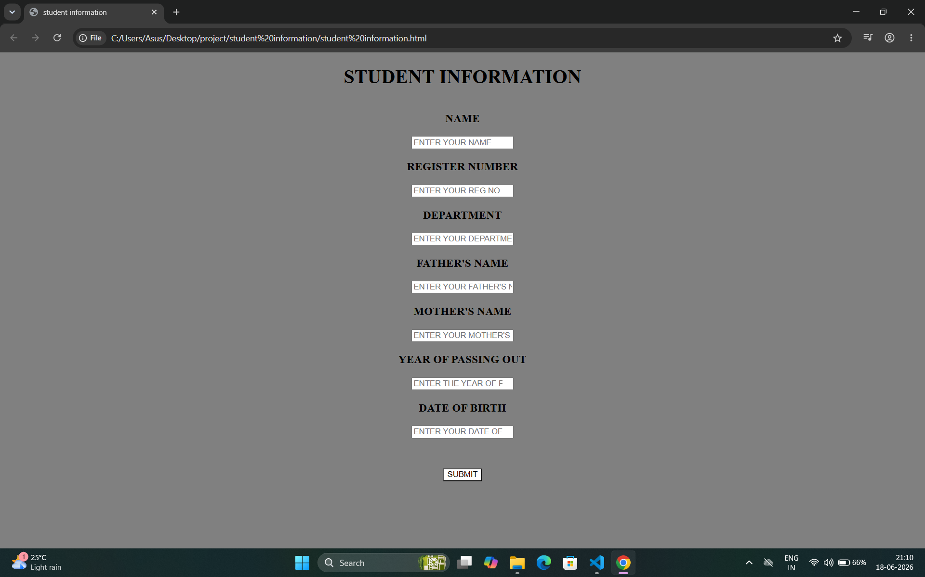
SCREEN SHOTS

Slide 5
THANKYOU

